Slide 1

Product Sales Method Analysis
MD Zehan Alam

Slide 2

About Pens and Printer’s New Product Sales Methods
In past six weeks, we’re running a campaign to boost sales of our newly launched stationary products.
We have utilized three different strategies:
Email: Received an email when the product line was launched, and a further email three weeks later
Call: A 30-minute call from the sales team
Email + Call: First sent the product information in an email, then called a week later by the sales team

Slide 3
Goals
How many customers were there for each approach?
What does the spread of the revenue look like overall? And for each method?
Was there any difference in revenue over time for each of the methods?
Based on the data, which method would I recommend we continue to use?

Slide 4
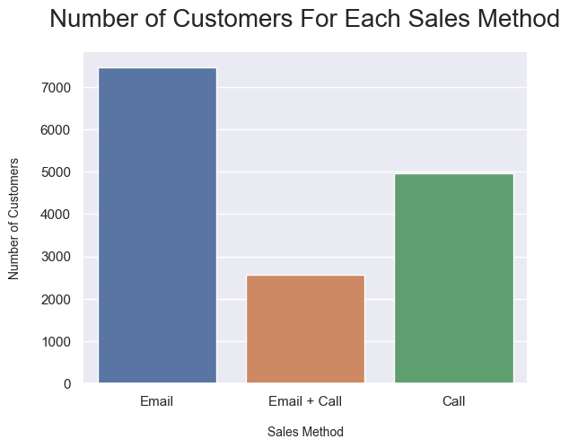
Number of Customers For Each Sales Method
15,000 Recorded Data
Nearly 50% of our customers were acquired through “Email” method
“Call” method brings double the number of customers than “Email + Call” method

Slide 5
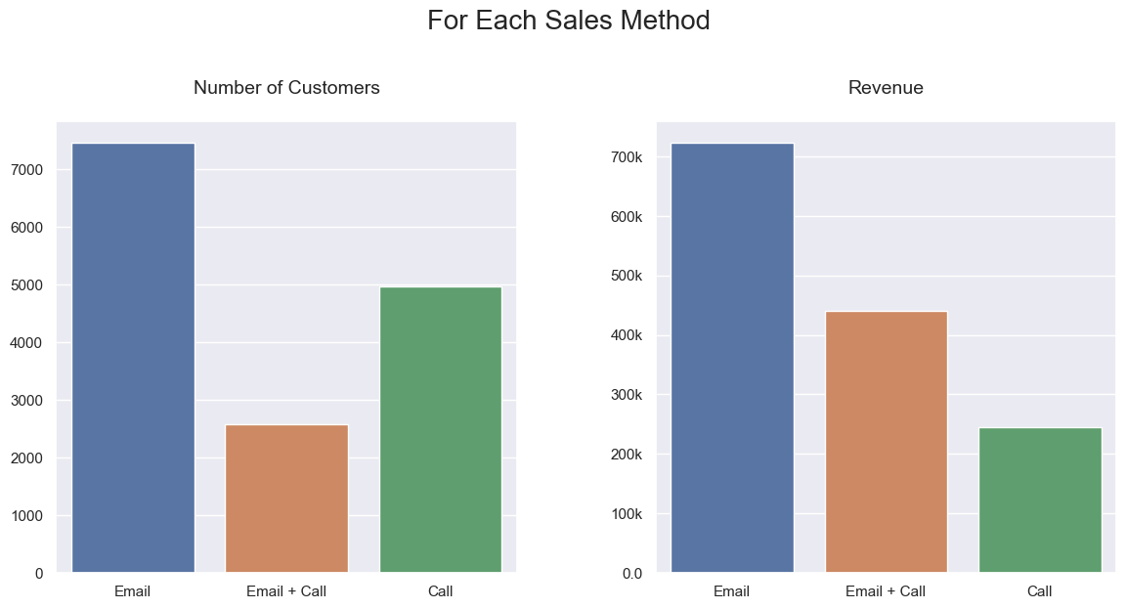
Comparing Number of Customer and Revenue

Slide 6
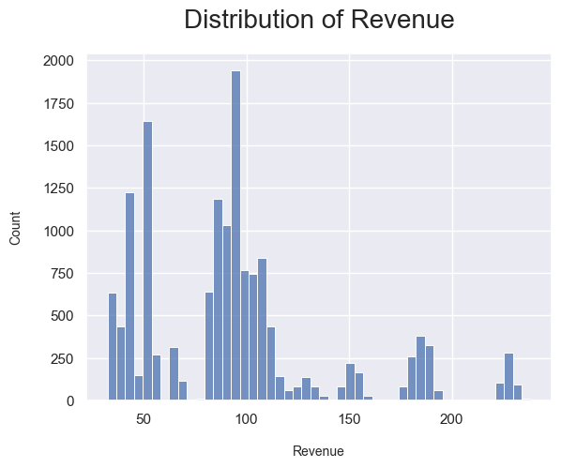
Distribution of Revenue
It’s Multimodal distribution graph.
Two prominent spikes indicates that a significant portion of our customers made purchases of approximately 50$ or 100$ worth of products

Slide 7
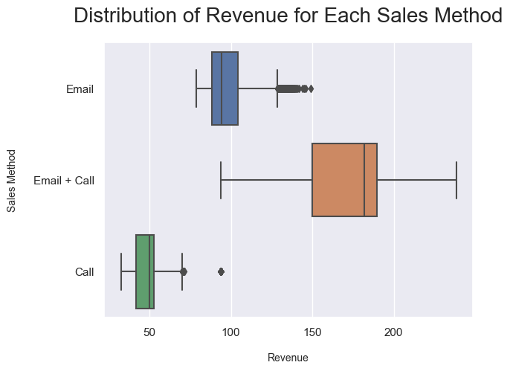
Distribution of Revenue for Each Method
"Email + Call" method generates the highest revenue per customer
"Email" method occasionally matches the revenue of the "Email + Call"

Slide 8
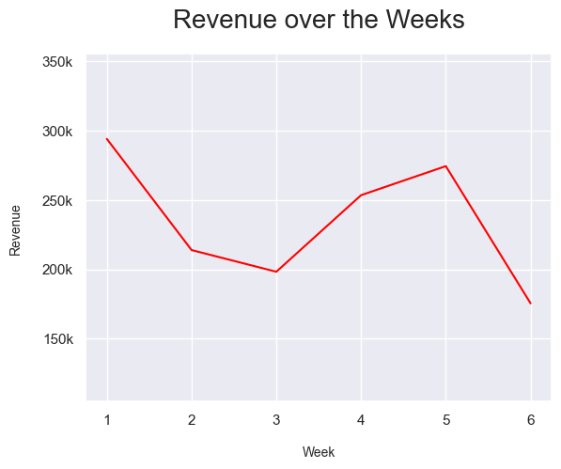
Revenue Over The Weeks
Total Revenue per week were between $200k to $300k
Revenue peaked at first week
During the third week, in the "Email" method we've sent a second email to customers

Slide 9
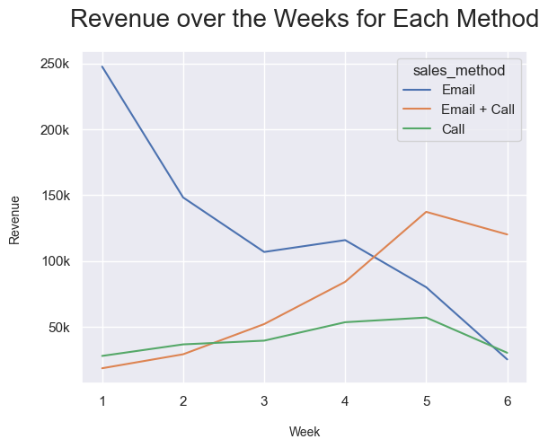
Revenue Over The Weeks
"Email + Call" method surpasses the revenue generated by the "Email" strategy between week four and five
Discontinue the "Call" method
”Email” method brings highest revenue and customers, but “Email + Call” method brings much more revenue from a single customer

Slide 10
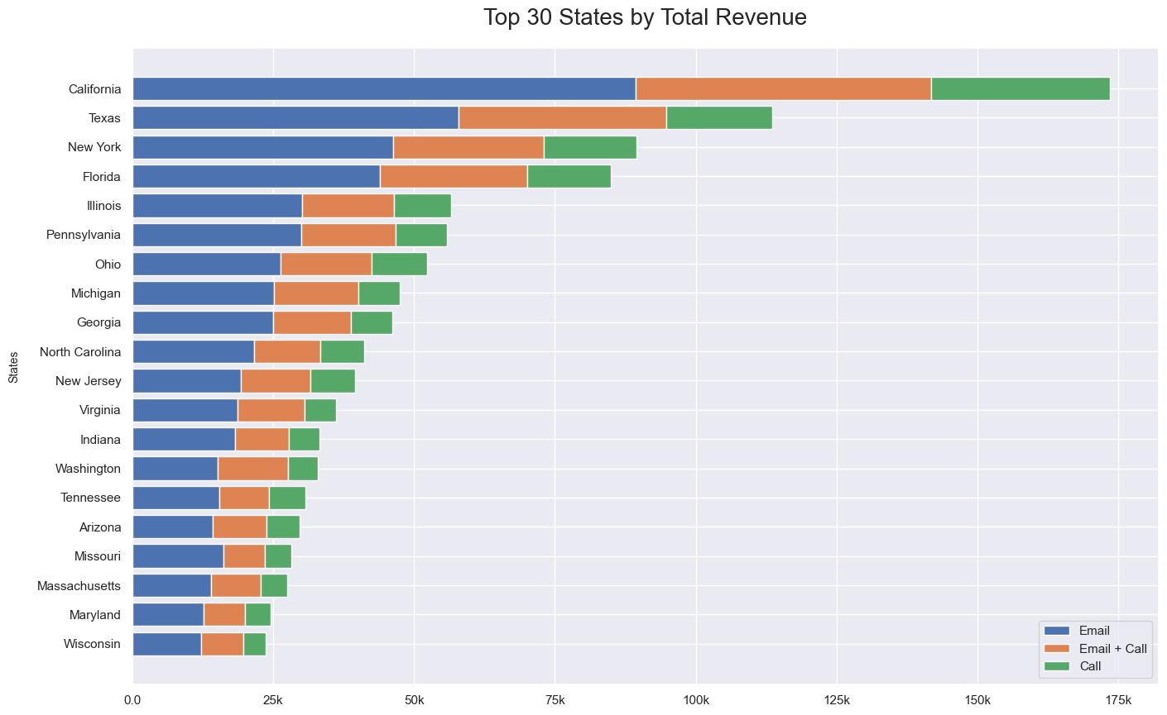
Revenue by States
Top 4 States:
California
Texas
New York
Florida

Slide 11
Business Metrics
Revenue over the Weeks
Total revenue over $200k per week

Slide 12
Recommendation
By closely monitoring key metrics, we can track the revenue trend to determine if it is increasing or not.
It is advisable to concentrate our efforts on the "Email" method.
Maintain a regular cadence of sending emails every two to three weeks.
Enhance the quality of advertisements included in these emails to attract more customers.

Slide 13
Recommendation
To maximize our marketing efforts, it is recommended to intensify our efforts in "California," "Texas," "New York," and "Florida". If we have resource using "Email + Call" method use this alongside "Email" method, as it gives higher revenue per customer and these states have higher chances of getting customer.
To gain more insights, it would be beneficial to gather additional information like "customer satisfaction", "their needs" for further research.

Slide 14


Thank you
Product Sales Method Analysis
By
Zehan Alam

